Slide 1

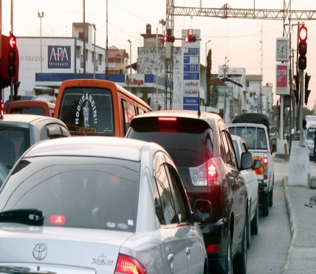
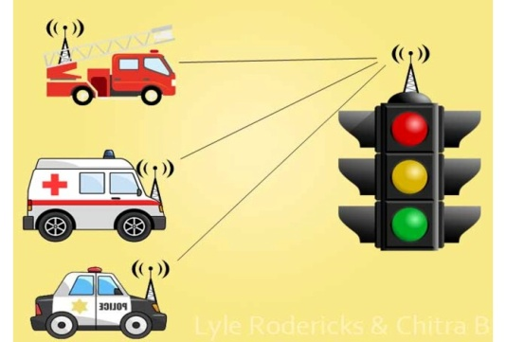
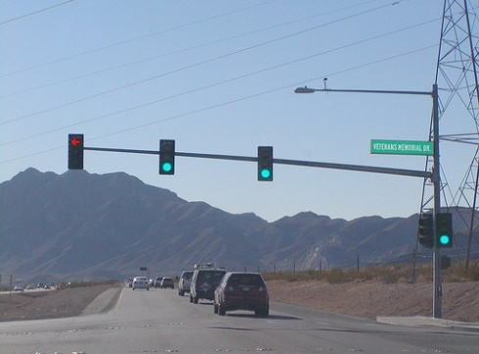
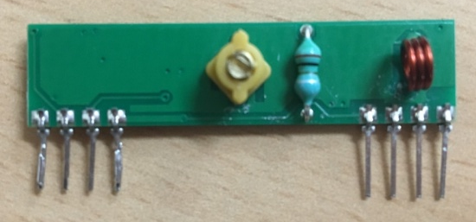
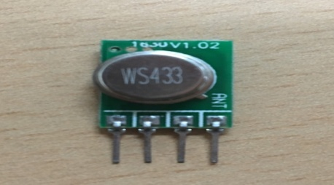
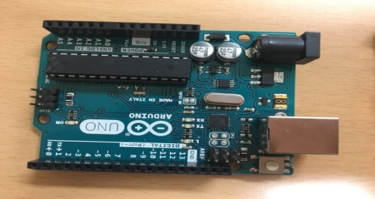
Z
KYUNGSUNG UNIVERSITY
FIRST YEAR ENGINEERING DESIGN PROJECT- 2018
‘INTELLIGENT TRAFFIC
SIGNAL’
TRAFFIC SIGNAL RED
GIVING RF SIGNAL
FREE WAY
Purpose and benefits of the signal
Because of red signal and the density of vehicle infront of emergency vehicle ,lots of time waste. so our system can save time of emergency vehicle. (For example : a small fire can double in size in 17 seconds)
Sometimes police car follow violent cars and it become dangerous for police to cross the road without getting green signal so our system will reduce crash rate .
Specific vehicle will only get the response.
MAIN ELEMENTS
RF TRANSMITTER
ARDUINO
RF RECEIVER
FUTURE PLAN
Our project can work only in two way road but in future we want to use it for junction.
For getting direction and specific distance we will fix RF RECEIVER away from traffic signal .We will use IR sensor for vehicle density .
When the TRANSMITTER will start giving signal to receiver, the driver will get very attractive sound for ensure.
Range is very important for changing the signal ,so we will try to fix the specific range to get the signal from emergency vehicle . (approximately 300 meter).

